Slide 1
Quick Eats
Kalpit Mody (Scrum Master)
Jack St. Hilaire (Developer)
Leah Harper (Developer)
March 01, 2022

Slide 2
The Problem

Slide 3
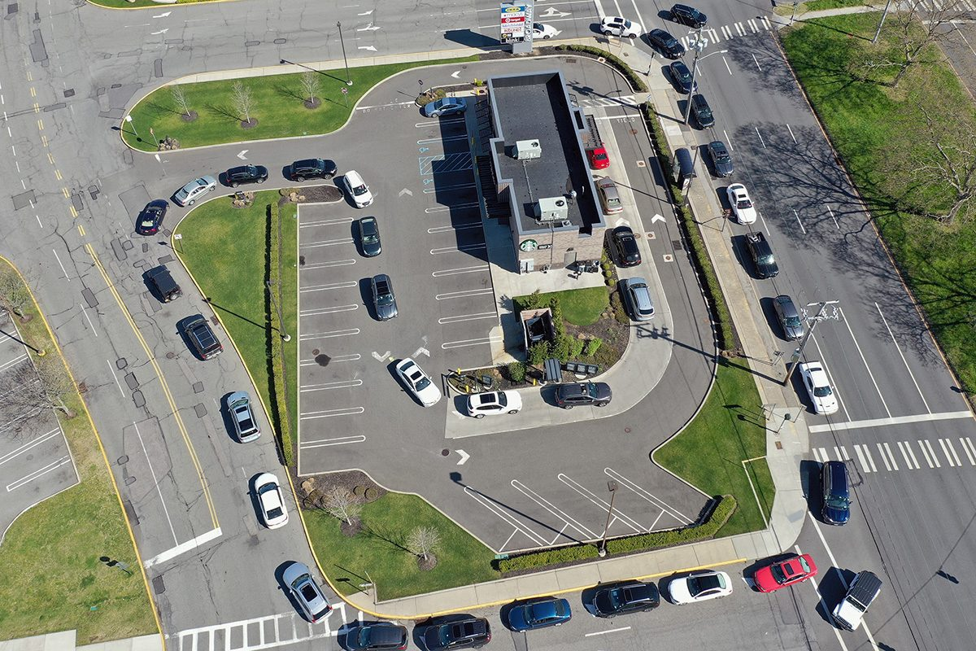
What is the issue at hand?
Crowded cities lead to long wait drive thru times
Increase in demand for drive thru service
Demand for quick service
Notes:
People spend upwards of 2 hours to get their food when going through a drive thru.
With the pandemic, more people prefer to grab food quickly on the go rather than dining in which leads to an increase in drive thru traffic.
People want the quickest service they can possibly get.

Slide 4
Our Solution
Notes:
So we have created a solution for this issue

Slide 5
What is Quick Eats?
A mobile application that analyzes and displays live drive-thru wait times at fast food restaurants
Decreased time spent waiting in fast food drive-thrus
Reduced stress & pressure on fast food employees
Optimize traffic patterns in busy areas
Notes:
Quick Eats
We will be creating a mobile application that analyzes and displays live drive thru wait times at fast food restaurants.
This solution will lead to a decrease in wait times in drive thru lines, a relief of stress and pressure that fast food workers face, and over time will lead to optimized traffic patterns in crowded areas.

Slide 6
Functional Requirements
Notes:
Let’s get into some of the functional requirements for this project to better understand its features.

Slide 7
FUNCTIONAL REQUIREMENTS (VIEWING RESULTS)
View Welcome Page - User views welcome page where they can leverage our search feature
View Restaurants on Map - User views fast food restaurants near a specified location on a map
View Restaurants in List - User views search results in a list
View Favorite Restaurants - User clicks a favorites tab to view their favorite restaurants
View Estimated Live Wait Times - User clicks on a fast food restaurant which tells users of the live estimated wait time
Notes:
Here you can see some of our main functional requirements for this project.

Slide 8

FUNCTIONAL REQUIREMENTS (SEARCHING)
Ability to Search - User has the ability to use their current location or enter a location to search for fast food restaurants
Ability to Filter and Sort - User has the ability to select pre built filters and sort their search results in the list view

Slide 9
FUNCTIONAL REQUIREMENTS (MANAGING ACCOUNT)
Sign Up - User provides an email, phone number, or Google account to register an account
Log In - User enters their credentials to gain access to our application
Create User Profile - User enters personal information along with preferences such as favorite restaurants and location
Log Out - User is able to sign out of their account
Notes:
Some of the functional requirements that will help users manage their account include the basics of signing up, logging in, creating a user profile, and logging out.
For signing up, the user opts in to create an account on our platform by using an email, phone number, or Google account.
From a logged out state, the user can login by using their credentials.
When the user signs up, they will also be able to create their user profile which consists of filling out a form that asks for the user’s personal information and preferences such as name, their favorite restaurants, and their location. This allows our application to be more personalized.
Finally, the user will be able to log out leading them to the Sign Up/Login page.

Slide 10
Non Functional Requirements

Slide 11
NON FUNCTIONAL REQUIREMENTS
Useful Notifications - Users will be notified about relevant (exceptionally short or long, etc.) wait time lengths according to their preferences
Self-Reported Data Analytics - Users will be able to self report when drive through lines are long or short at various restaurants (like Waze)
Network Security - The application will be protected from unauthorized access and misuse
User Data Privacy / Security - All user data will be protected against unauthorized access through encryption
Notes:
Useful Notifications - VIEW FAV RESTAURANTS - users can configure their notification preferences in their profile and can choose to be notified about long wait times, short wait times, wait times regarding their favorite restaurants, wait times in their area or set time preferences to get notifications
Self-Reported Data Analytics - VIEW ESTIMATED LIVE WAIT TIMES
Network Security - SIGN IN, LOG IN, USER PROFILE
User Data Privacy - SIGN IN, LOG IN, USER PROFILE

Slide 12
NON FUNCTIONAL REQUIREMENTS - TIME RELATED
Efficient Filtering and Sorting - Filtering and sorting should return in less than 500ms
Efficient API Interactions - API Interactions should return in less than 0.5 seconds
Search Result Time - Search results should return in less than 5 seconds
Notes:
Important to do all of these quickly so the user does not get bored and leave the app
Filtering and Sorting - ABILITY TO FILTER AND SORT - should be easy since the data is already in the app
API Interactions - VIEW RESTAURANTS ON MAP - used for maps
Search Result Time - ABILITY TO SEARCH - studies show that people lose interest in search results in 7 seconds

Slide 13
Use Case

Slide 14
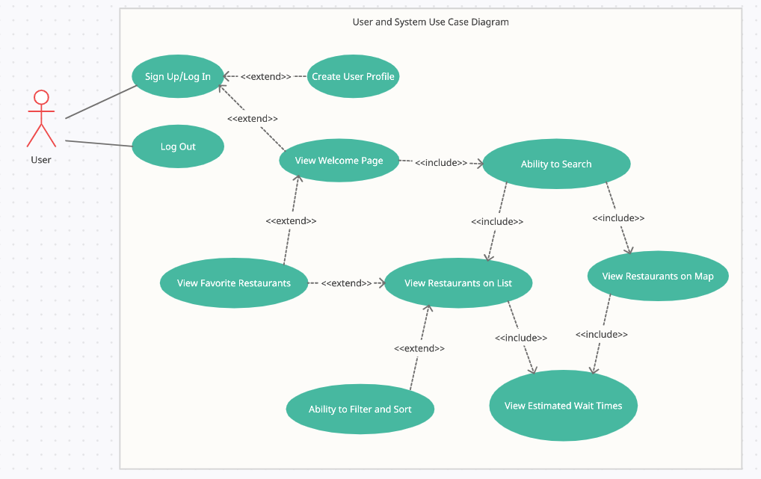
USE CASE DIAGRAM
Notes:
Go through a scenario for what a user would see / do when using the app
Extend - The extending use case is reliant on it’s base case. It is often optional and would not make sense without the base case context
Ex: View Favorite Restaurants extends View Welcome Page. View Welcome Page exists on it’s own but is enhanced by View Favorite Restaurants
Include - The including use case is essential to its base case. Without the included use case the base case would not make sense
Ex: View Restaurants on List and Map include View Estimated Wait Times because without View Estimated Wait Times the List and Map views would be irrelevant

Slide 15
System Constraints

Slide 16
Tool and Language Constraints
React (Mobile Application Framework) - We will utilize the react framework to deploy both the back and front end of our application
Amazon Web Services - AWS cloud storage will allow us to maintain scalability and secure data storage capabilities
JavaScript - Using JS with the React framework will allow us to develop for multiple platforms concurrently
SQL - Database interaction language that we will use to communicate with relational databases that we construct for this application

Slide 17
Platform and Hardware
Mobile App Platforms - Through utilizing React, we will aim to develop for all popular platforms such as IOS, android, etc.
Mobile Device - Underlying hardware will guide design choices throughout the process, focusing on special considerations for popular phone models is key

Slide 18
Network, Deployment, and Transition
Internet Connection - The application would not function properly if users do not have a connection to the internet
Deploy to App Stores - Using Firebase to deploy, we must consider all rules and regulations of various stores and marketplaces
Timeline - This project must be completed by the end of this semester
End of Life - When this class ends, someone else will have to take over the implementation of this project

Slide 19
Evolutionary Requirements
View Analytics (Functional) - We will collect data as the app is being used to increase efficiency and usability over time
Precondition - Users must go through process of using the app for an
extended time period
Postcondition - The data we gather will be able to help guide decision making
based on trends
Maintain Accurate Data (Non-functional) - To maintain privacy and security for our users, data must be both accurate and secure

Slide 20
Questions?

